Slide 1


Tuesday, 8 November
ESRC Festival of Social Science 2016
Using the WISERD DataPortal to map civil society data
Scott Orford, Ian Harvey
Wales Institute of Social and Economic Research, Data & Methods (WISERD)

Slide 2
Plans
DataPortal Demo – With a focus on the mapping of remote data sources (Nomis and StatsWales), and user data relevant to civil society researchers.
The presentation will also include the work recently completed with the National Assembly.
Following this, a workshop session to try out the DataPortal yourselves.

Slide 3
WiserData
Data key resource for civil society / policy research
Large number of datasets available in Wales/UK BUT:
Lack of awareness/ knowledge about what data exists
Discovering data is not straightforward
£££ data is under-used
Awareness and discovery of social science data needs improving
Existing data needs to be optimised/repurposed/reused

Slide 4
DataPortal
Data:
Standards compliant meta-data for search and discovery
Quantitative / Qualitative socio-economic data
Web mapping services (WMS) feeds
API data feeds (NOMIS)
Geographic as well as thematic and temporal metadata searches
Portal:
Web-based system for discovering data resources- allows remote 24/7 searching

Slide 5
The WISERD Metadatabase
Surveys Include:
Census (1991, 2001)
Labour Force Surveys
Living in Wales Surveys (2004-2008)
National Survey for Wales
Shelter Cymru HAC data
Skills Surveys (various - 1997-2006)
Social Change and Economic Life Surveys (1986-1987)
Wales Rural Obs. Rural Business Surveys (2004-2010)
Wales Rural Obs. Household Surveys (2004-2010)
Welsh Health Surveys
Welsh Election Study
Welsh Referendum Study
Working in Britain Surveys (1999-2002)
Workplace Employment Relations Surveys (1998-2011)
WISERD Knowing Localities Stakeholder Interviews

Slide 6
DataPortal Core functionality
Textual database searching
Keyword / term search
Geographic/spatial searching
Place name gazetteer
Drop pin + circular distance buffer
Click and drag rectangular search area
Draw ‘freehand’ search area
Metadata reporting
Tabular output of question and responses
Metadata visualisation
Mapping
Word clouds

Slide 7
Demo #1
Regular DataPortal:
“MapMyData” from users XLS files
Remote data from Nomis + StatsWales
Custom Interfaces for different user groups
Dashboard
Custom search and mapping examples to guide usage
I.e. Homelessness, volunteering, social capital
Maps!
Custom data
Available for Region and Constituency boundaries
… also WMS layers, mapping of WISERD metadata ...

Slide 8
Why do we need it and who can it help?
PhD based on ‘Three Wales Model’
Needed some maps!
Tools of analysis and presentation
Mapping options
Various online attempts
Limitations
Alternatives
GIS software
Photocopying from books
We believe this scenario is likely to be true for all users who wish to map data without requiring previous knowledge of GIS mapping software

Slide 9
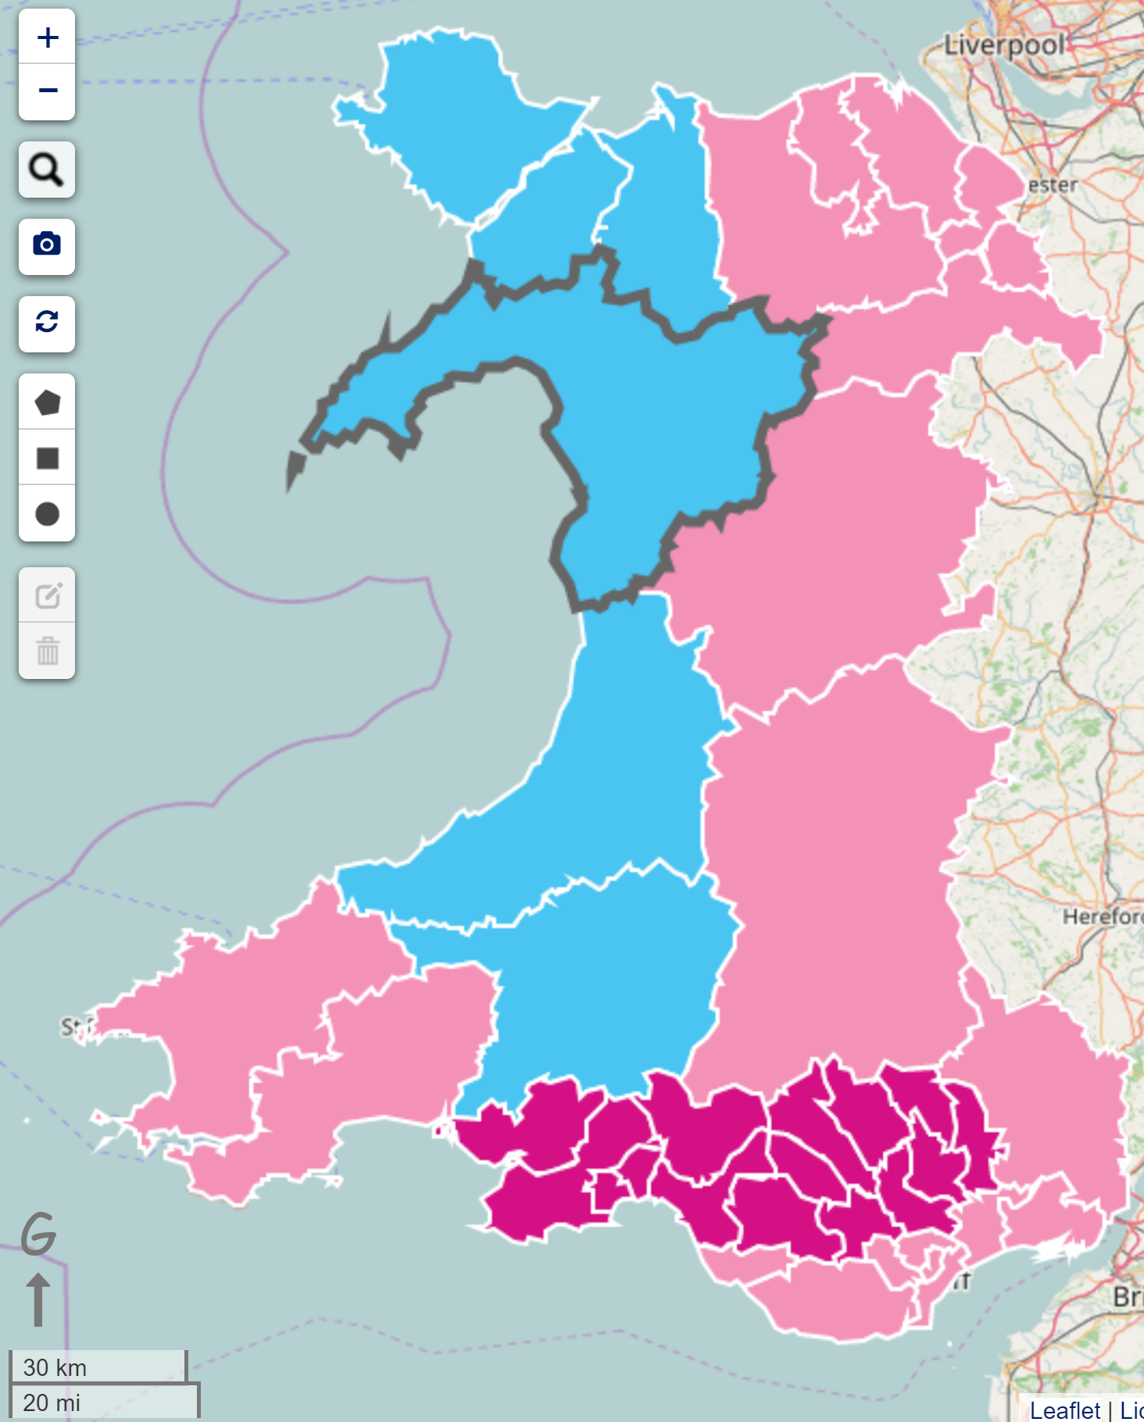
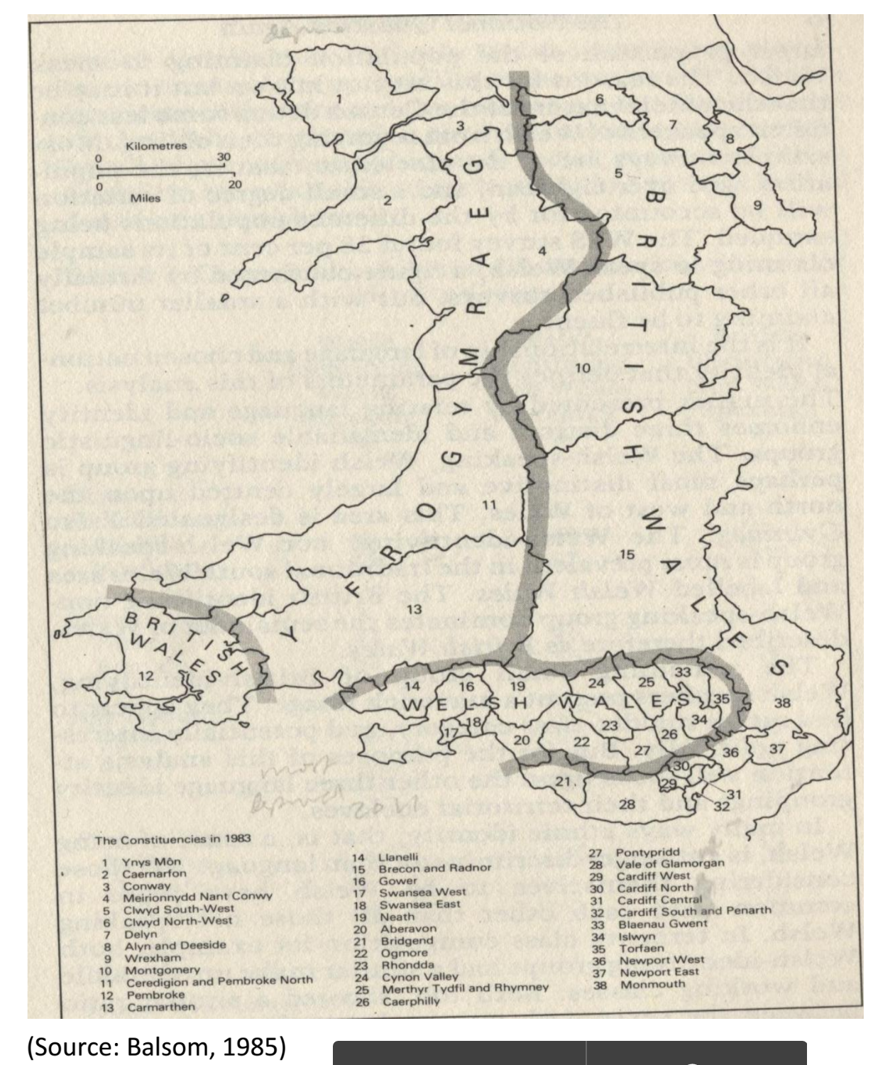
Old vs New

Slide 10
WISERD Metadatabase
WISERD Metadatabase innovations:
Metadata for surveys down to question-response level in a fully relational database
Semi-automated metadata generation for qualitative research data (keywords and place names)
Good metadata is the basis for effective:
Data discovery
Data management
Data sharing
Data harvesting
Data publishing
Data archiving

Slide 11
Demo #2
Survey and question banks
Listing
Search / Discovery
Getting to the data (*)
Transcripts
Word clouds of anonymised data
Data entry tools
Aim is to have metadata for all WISERD surveys
We want metadata for all datasets/ surveys of interest to civil society
WISERDEducation survey importing in progress
We can help!

Slide 12
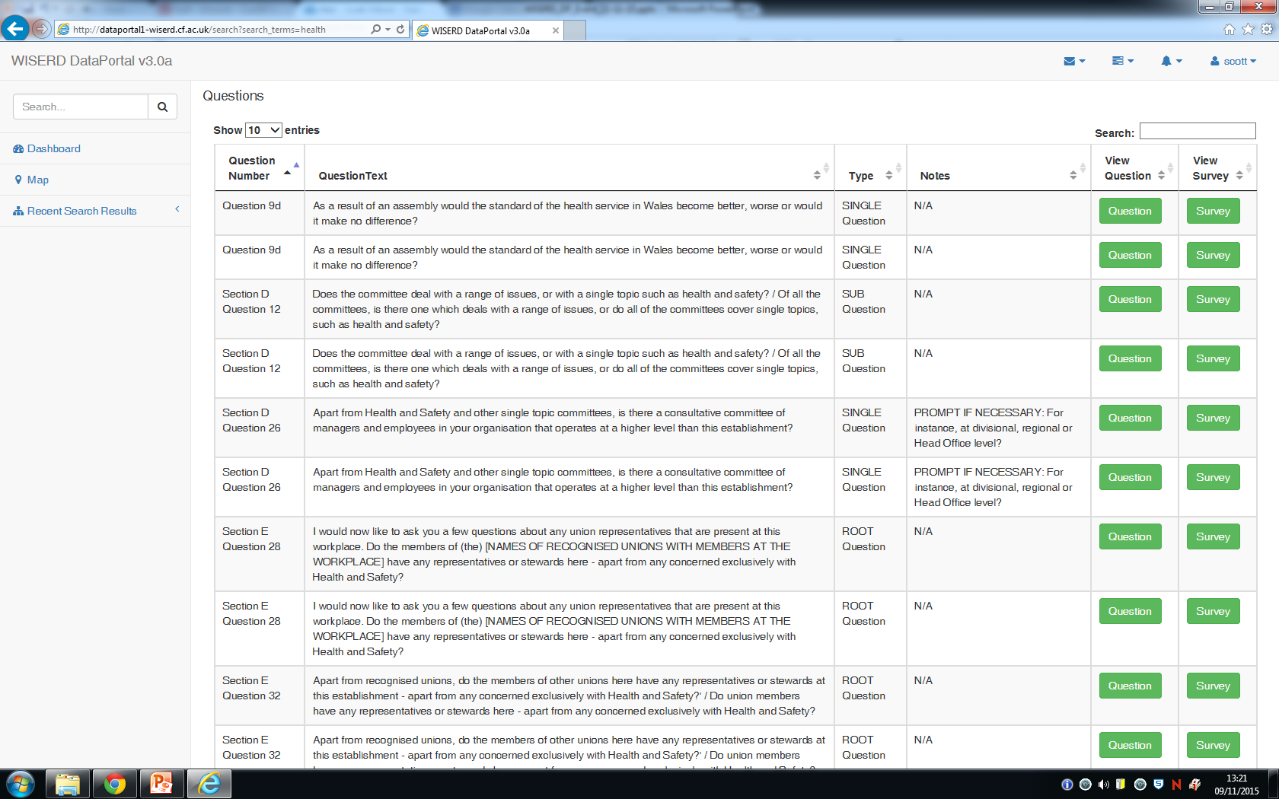
Metadata Survey/ Question Tables

Slide 13
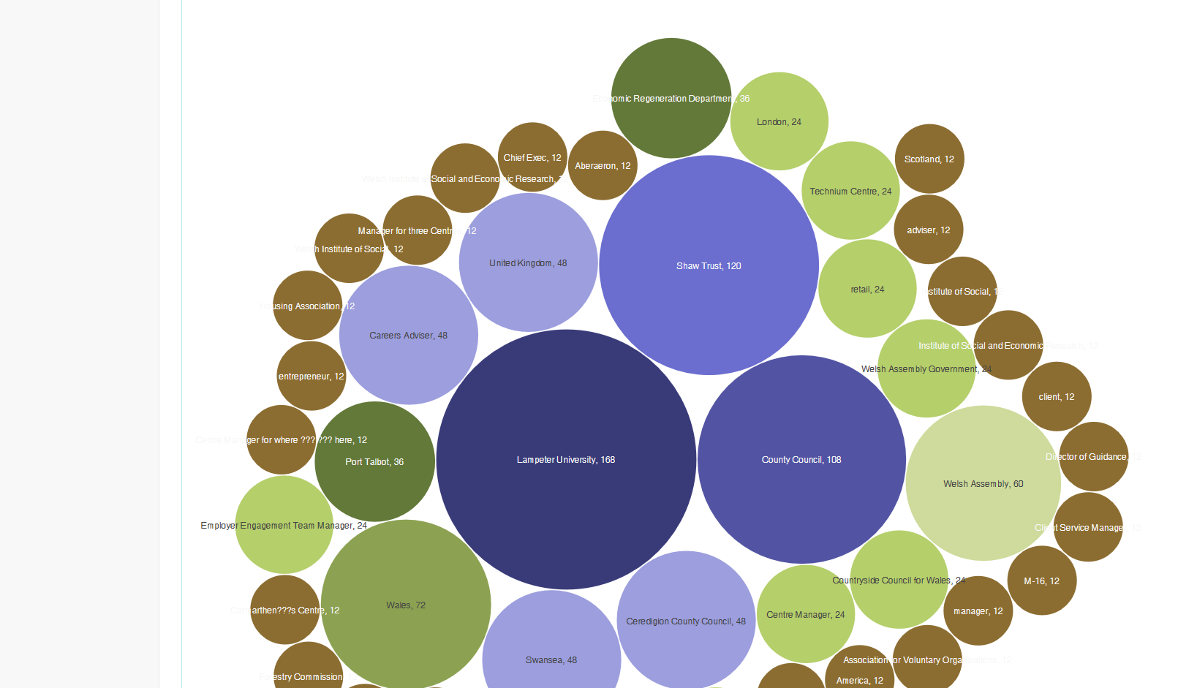
Word Cloud of WISERD Knowing Locality transcript

Slide 14
A DataPortal for Civil Society and Third Sector Groups
To flag civil society / third sector data in existing meta-database
To identify datasets of interest to civil society / third sector groups and populate in WDP
To work with WCVA and a targeted group of third sector organisations to shape the WDP for their data/ functionality needs
Develop use cases of WDP with civil society / third sector groups
Work with Wales ADRC on data access to civil society / third sector data

Slide 15
Future Developments
Workshops
Training sessions
Finding user groups
Following up with the National Assembly Research Service to ensure usage and measure Impact.

Slide 16
Any questions?
Boundaries and/or geographies?
Postcode
LSOA
Unitary Authorities
Wards/ Parishes?
Datasets and/or data providers?
What support do users need?
Now - Time to try it yourselves!

Slide 17

http://data.wiserd.ac.uk/
AVAILABLE NOW

Slide 18
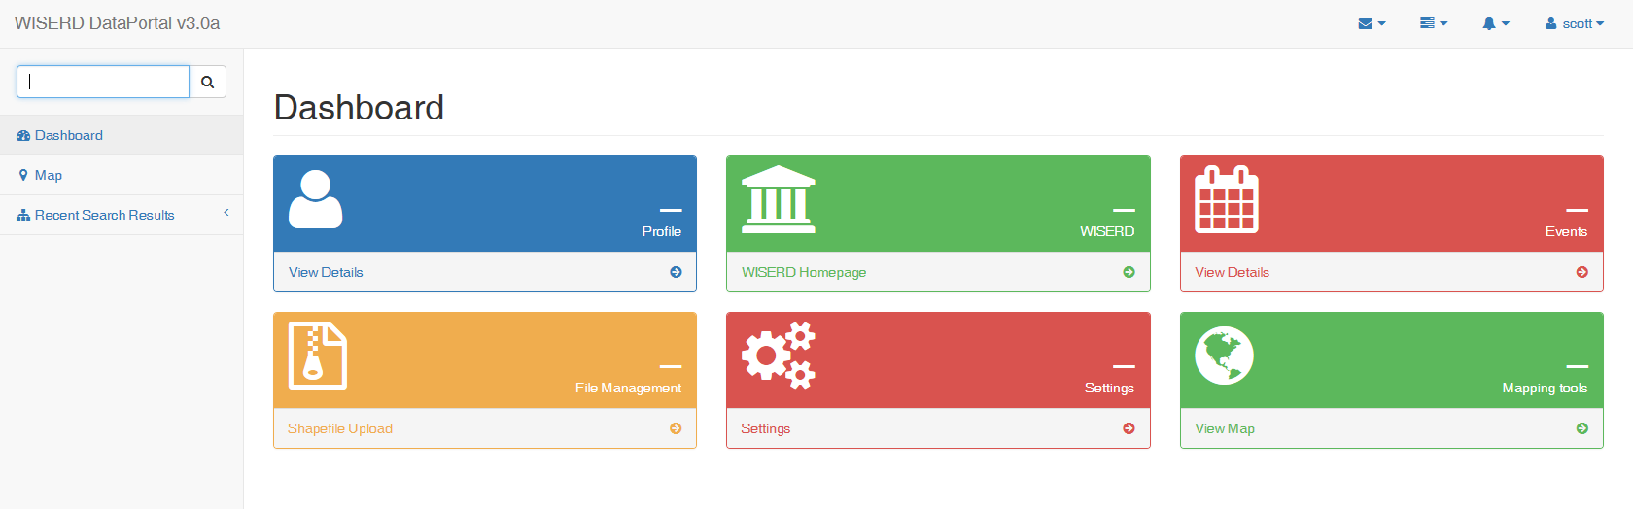
The WISERD DataPortal Home Page

Slide 19
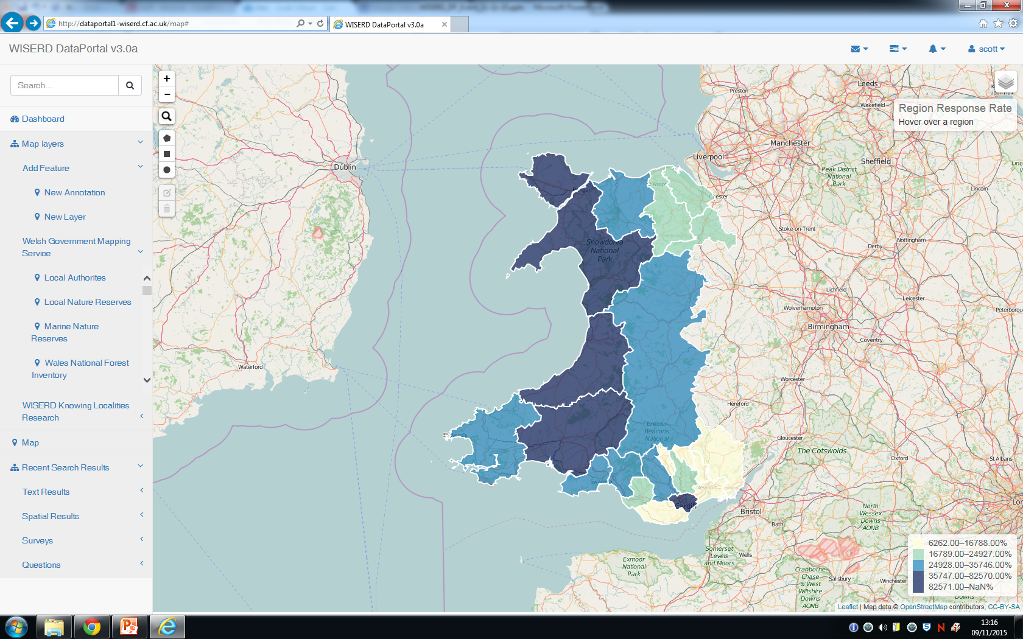
NOMIS data mapping tool - remote APIs

Slide 20
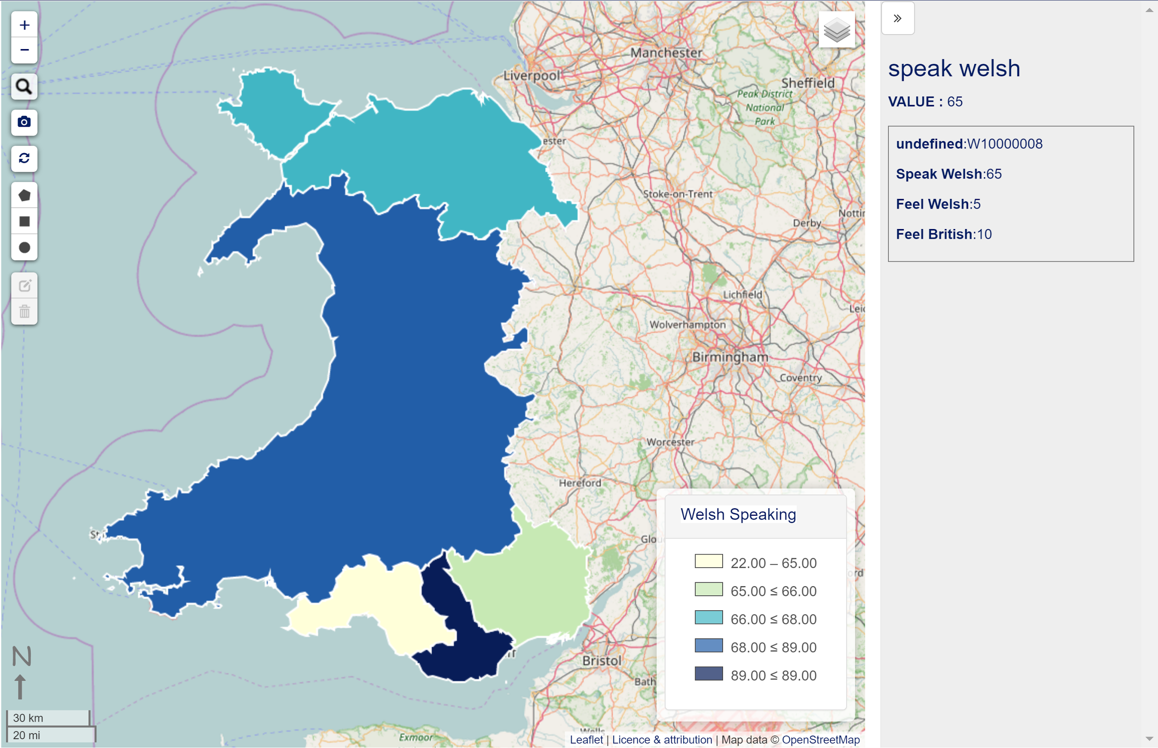
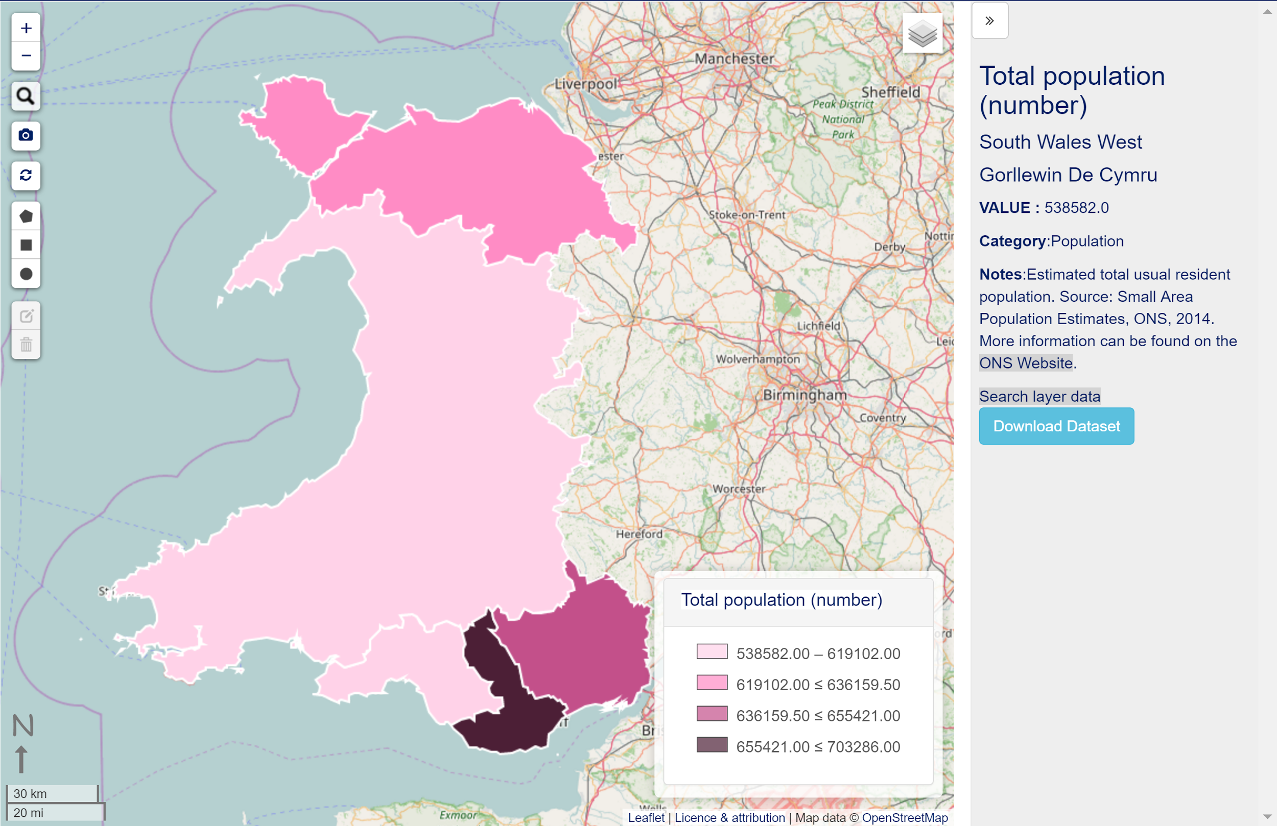
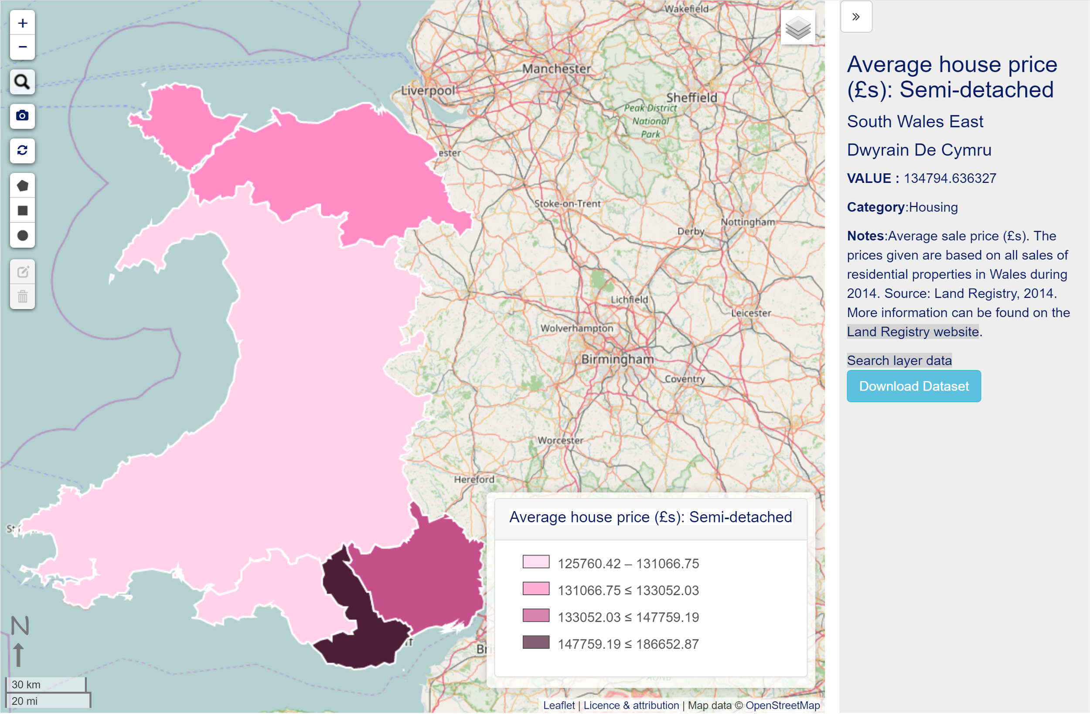
Example: Region level data
National Assembly data, available through bespoke interface.
MapMyData shown was mapped by the region name, in Welsh, also showing secondary data attributes

Slide 21
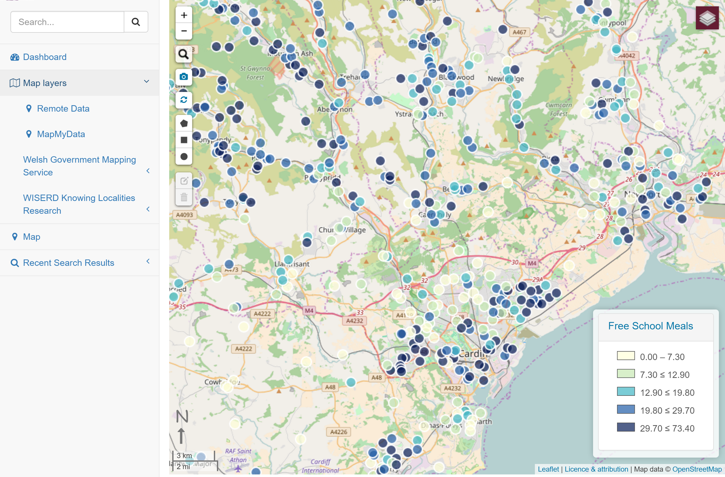
Example: MapMyData - Postcode points

Slide 22
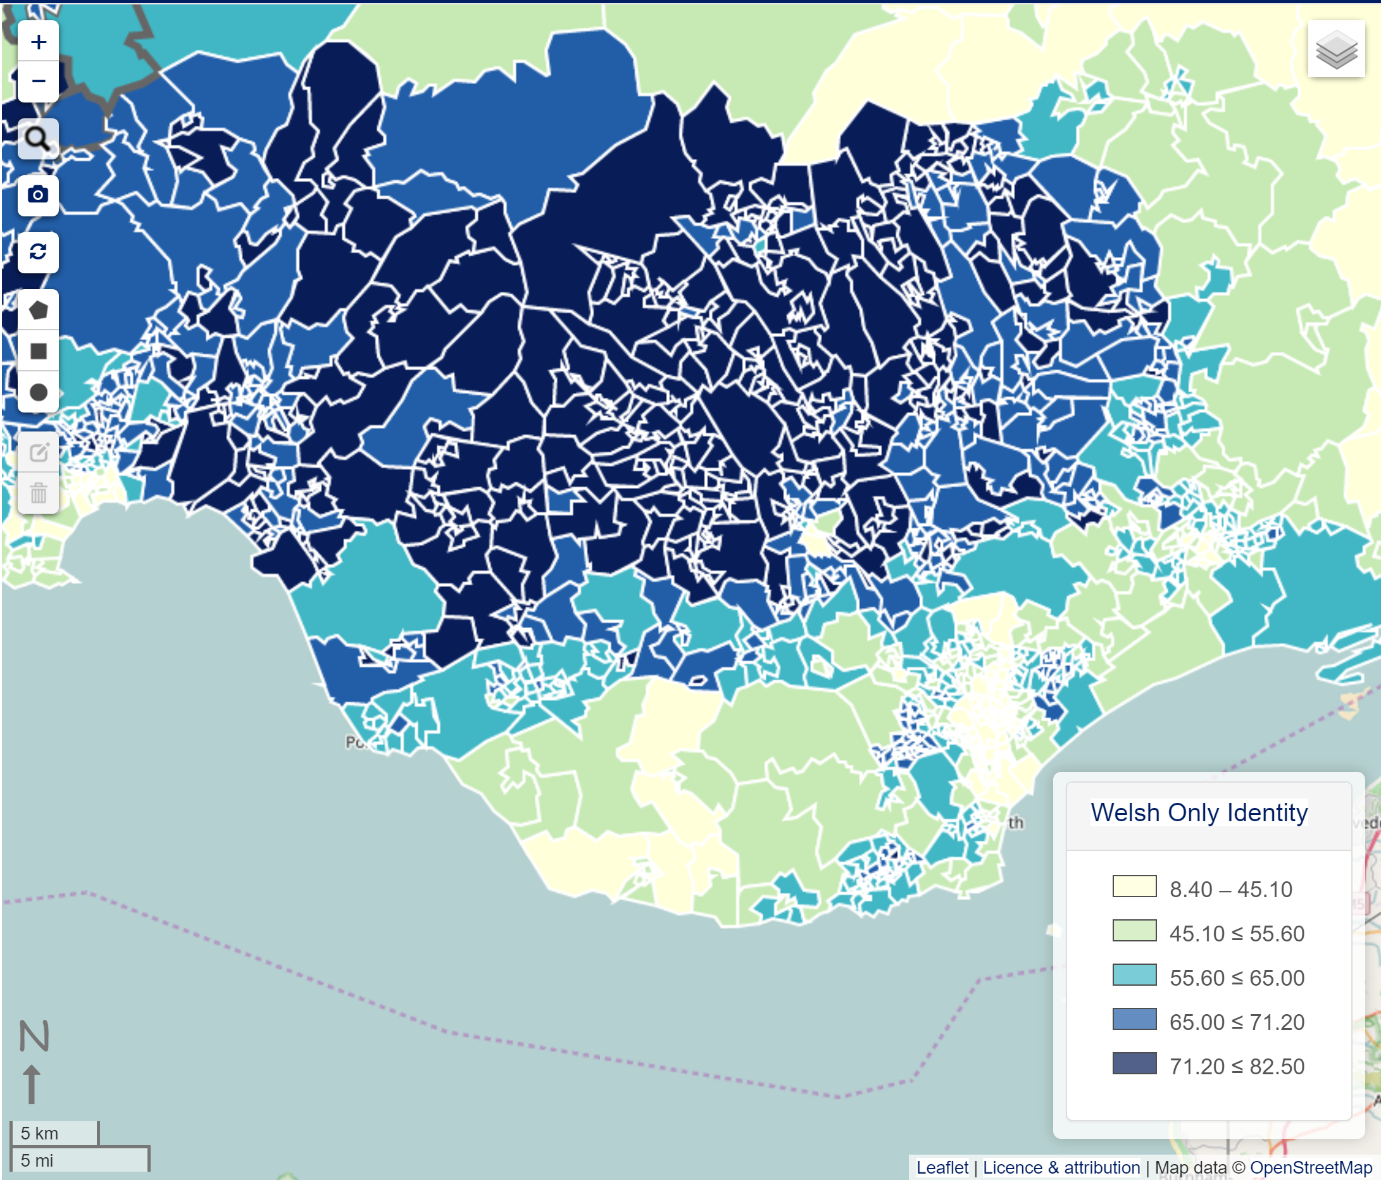
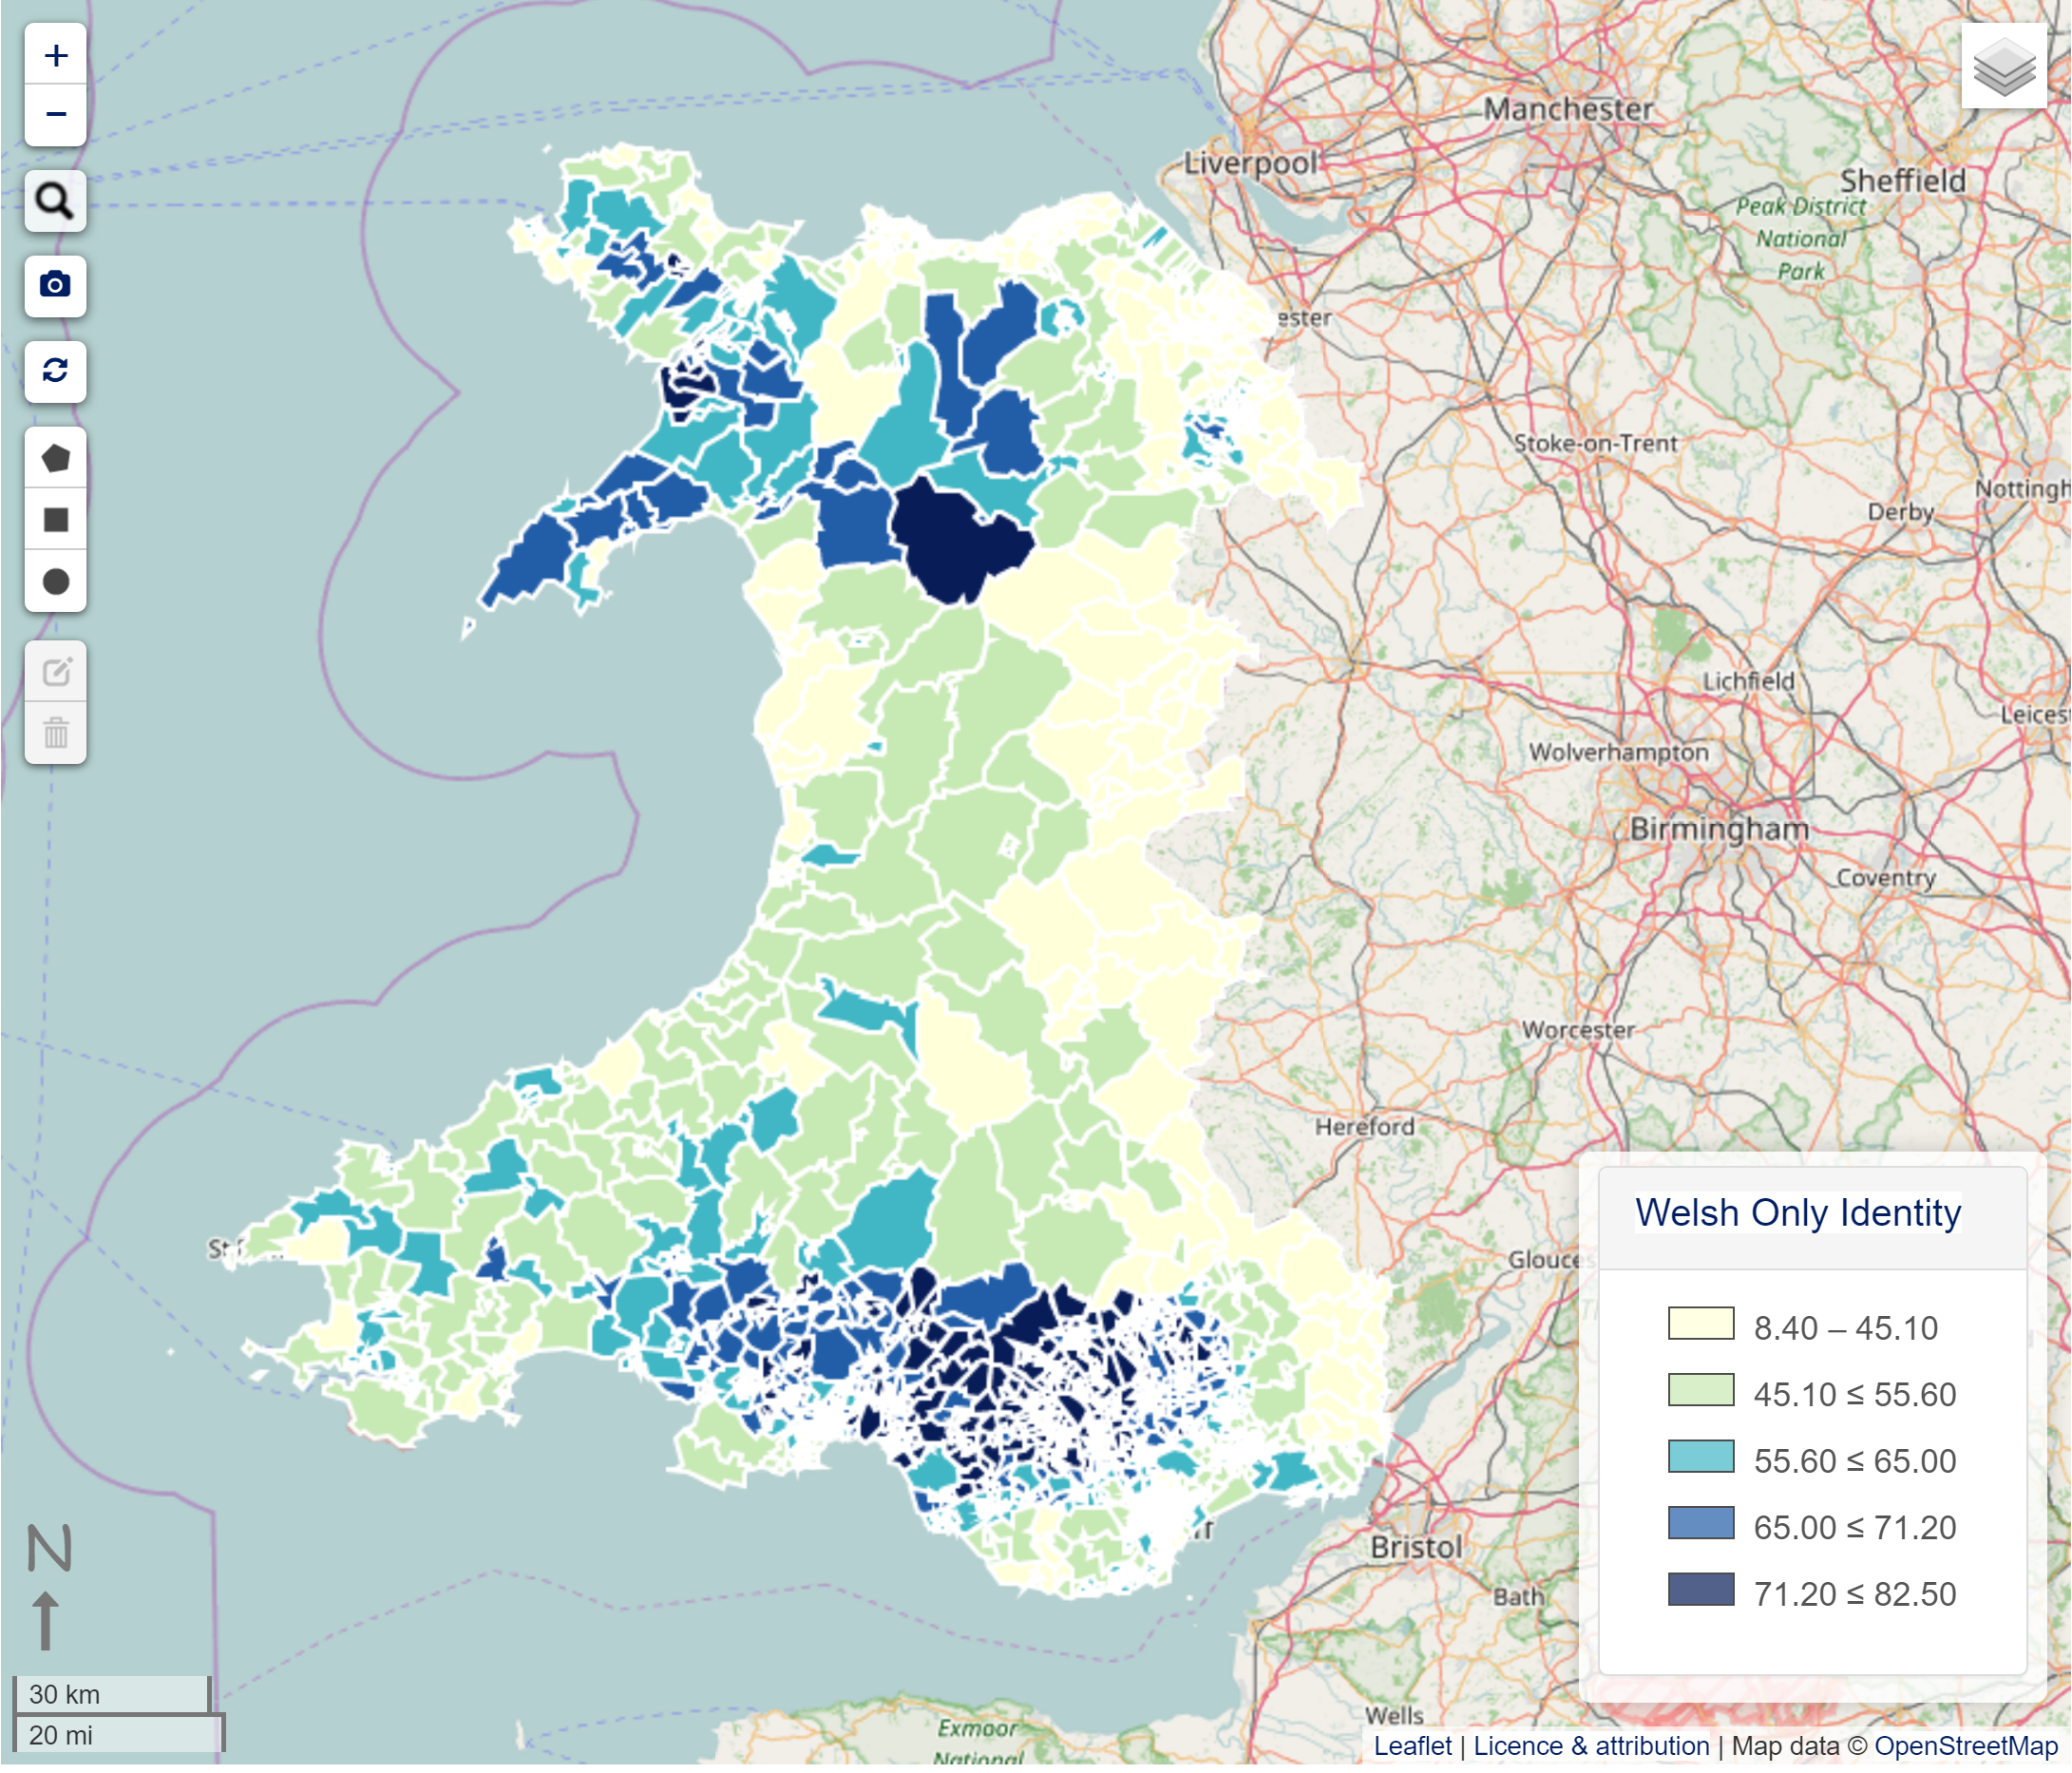
Example: Large datasets - LSOA
~2000 areas mapped. Data from Nomis by searching “Identity”.

Slide 23
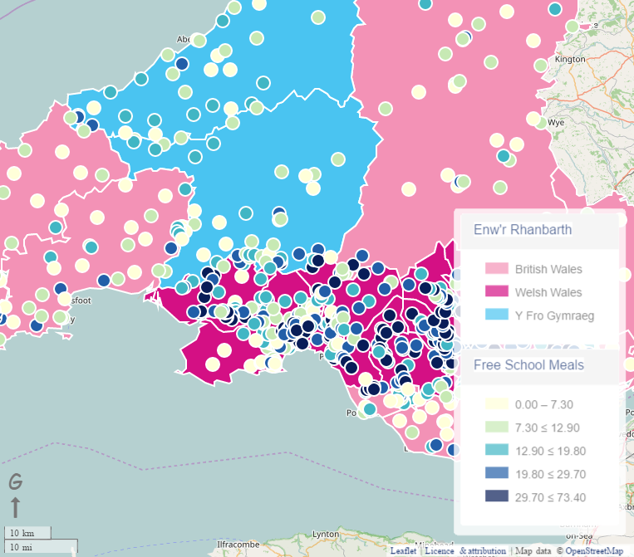
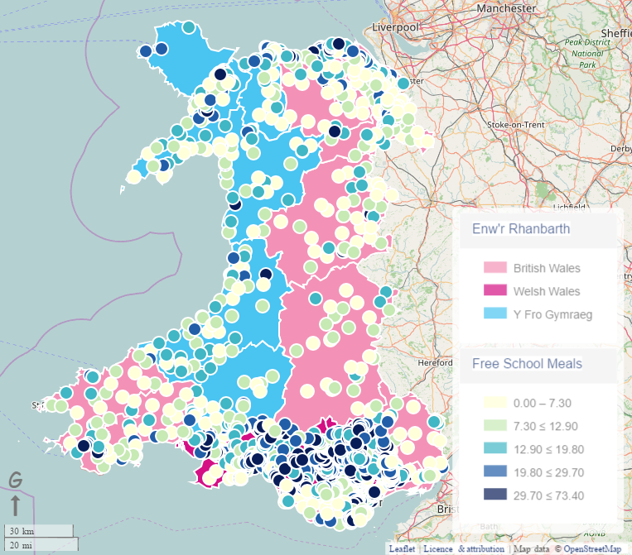
Data mashup
Local, remote and/or user data
3 Wales model by assembly constituency, with school postcode coloured by % eligible for Free School Meals

Slide 24
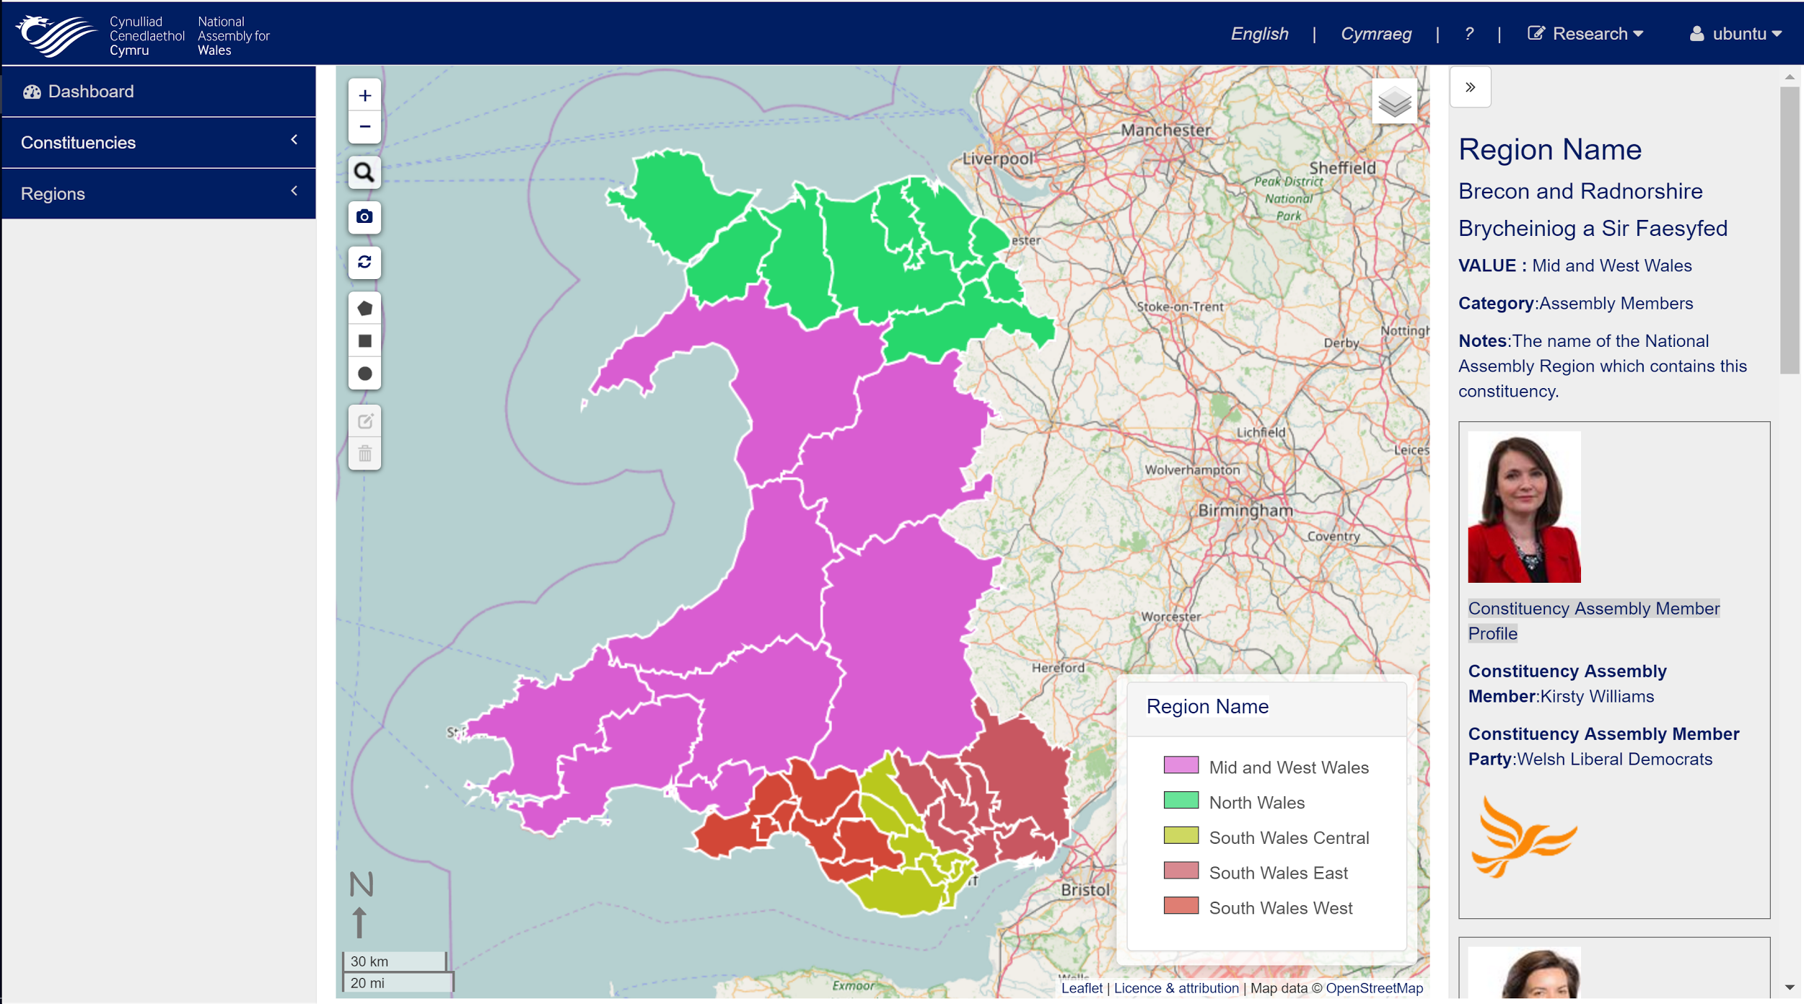
Example: Regions/ Constituencies

Slide 25
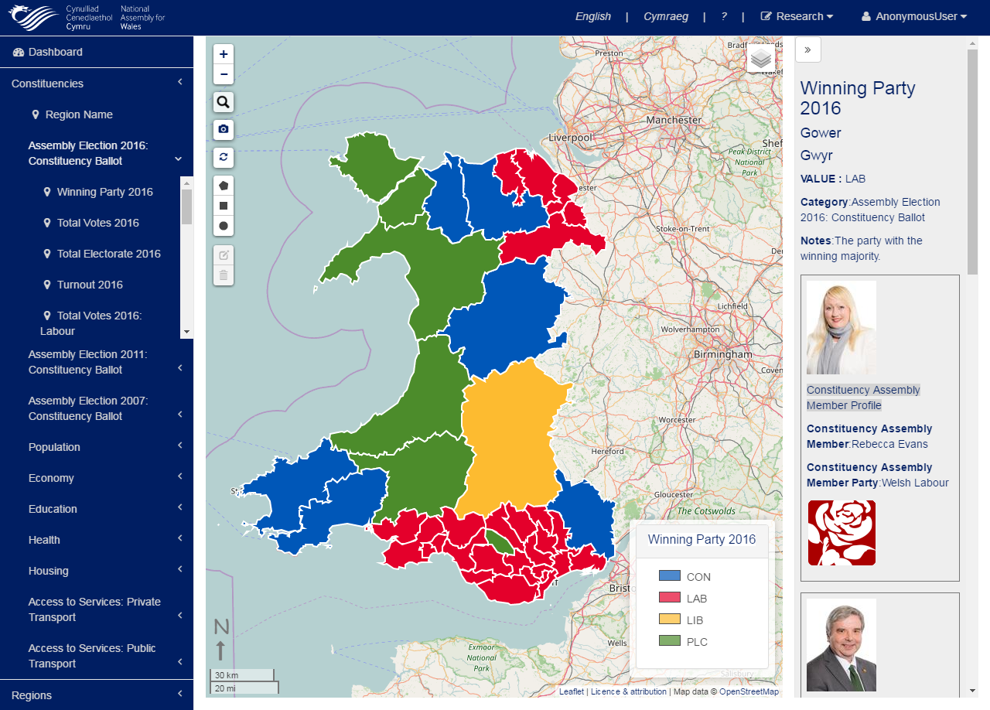
Data and features for specific use cases

Slide 26
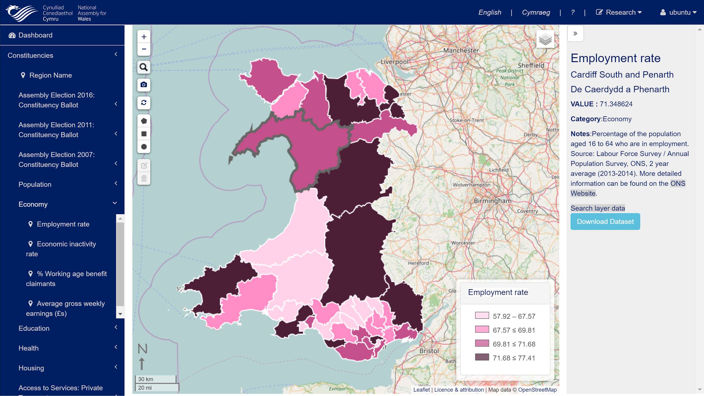
Example: Employment rate

